Slide 1
Divvy Bike
Analyze for Which Membership Type
Shall The Business Focus
By: Elkhateeb Naser
30-Oct-2022

Slide 2
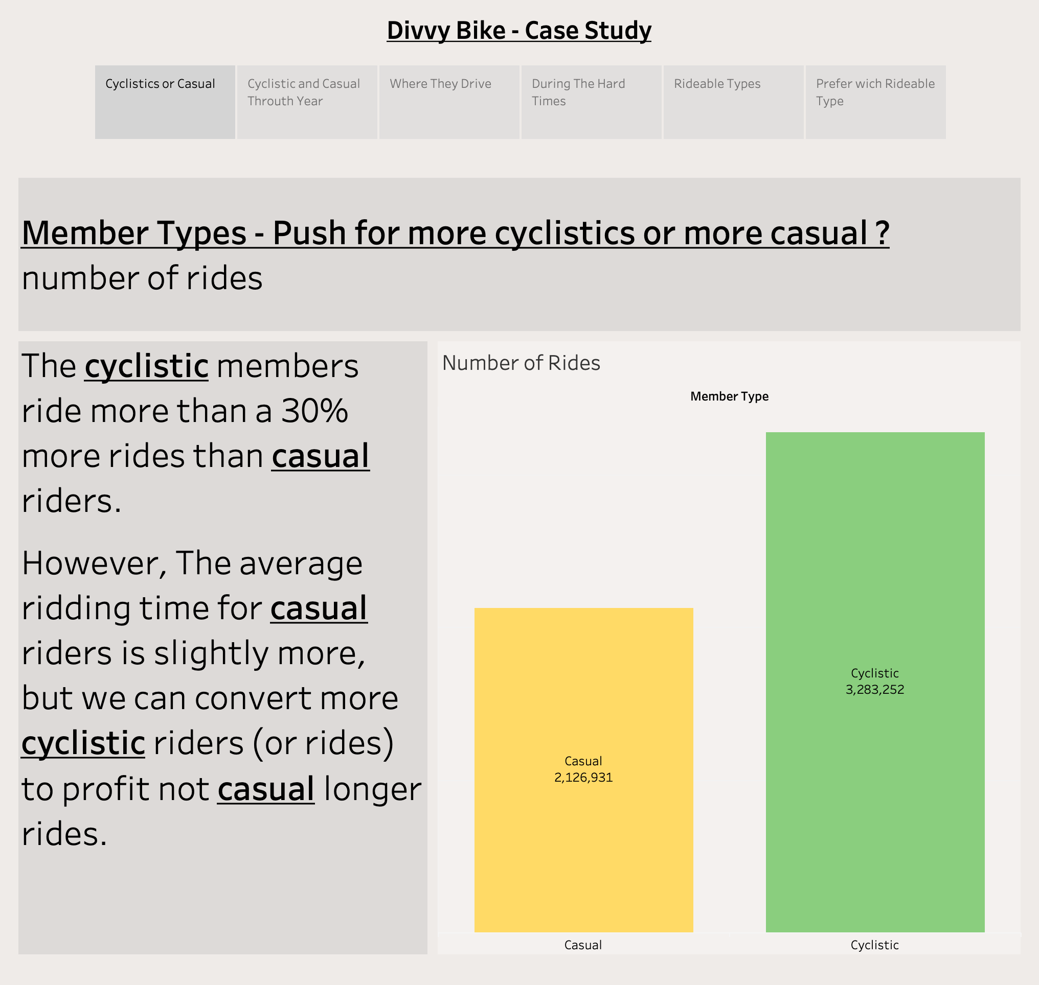

Slide 3
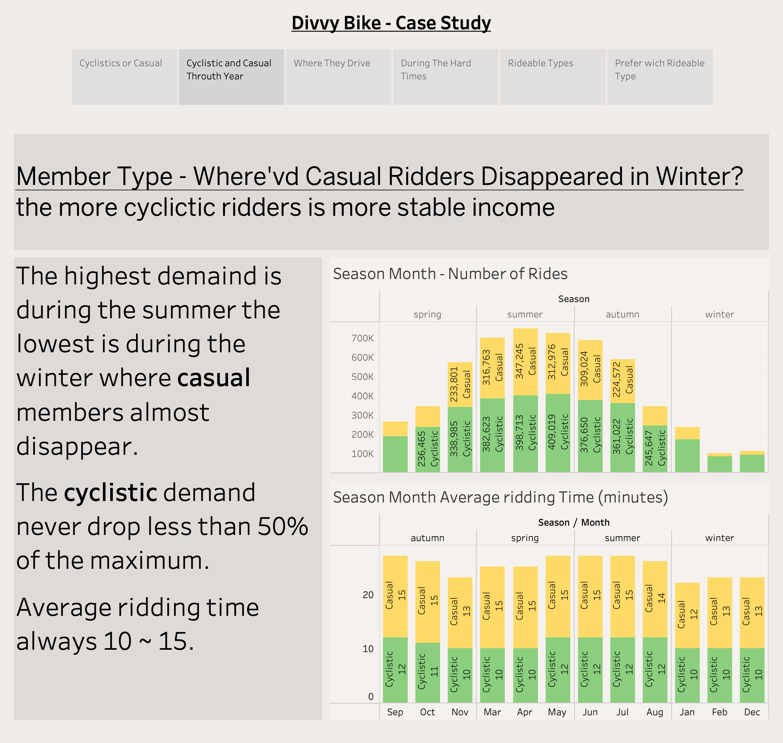

Slide 4
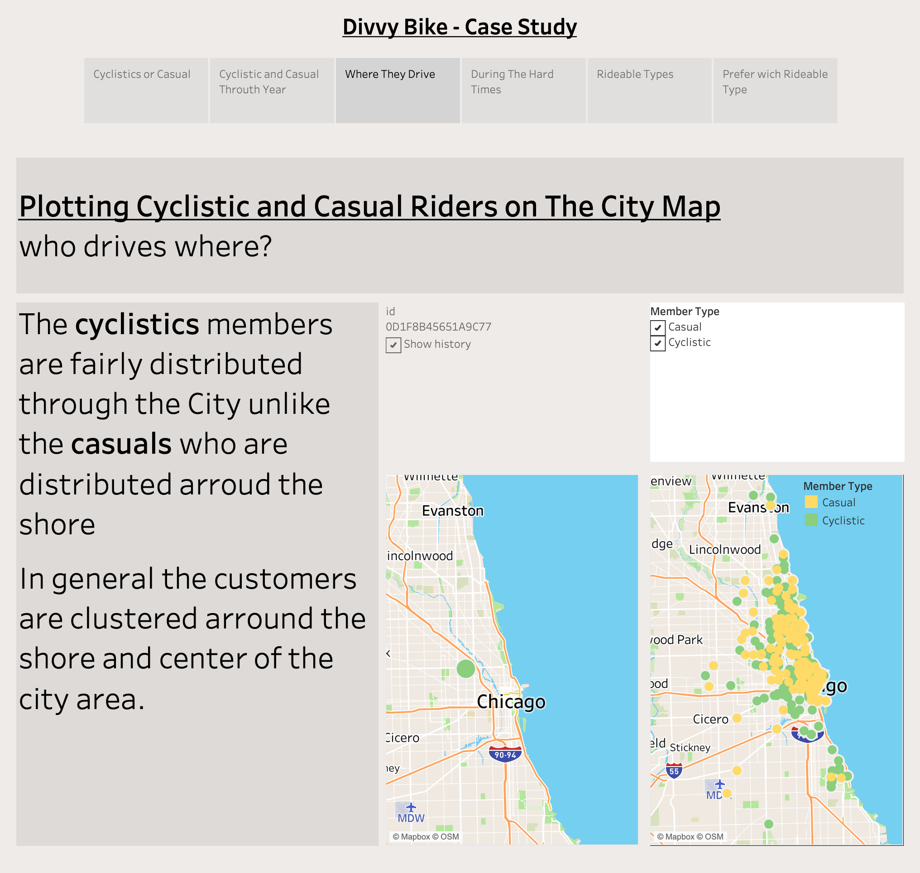

Slide 5
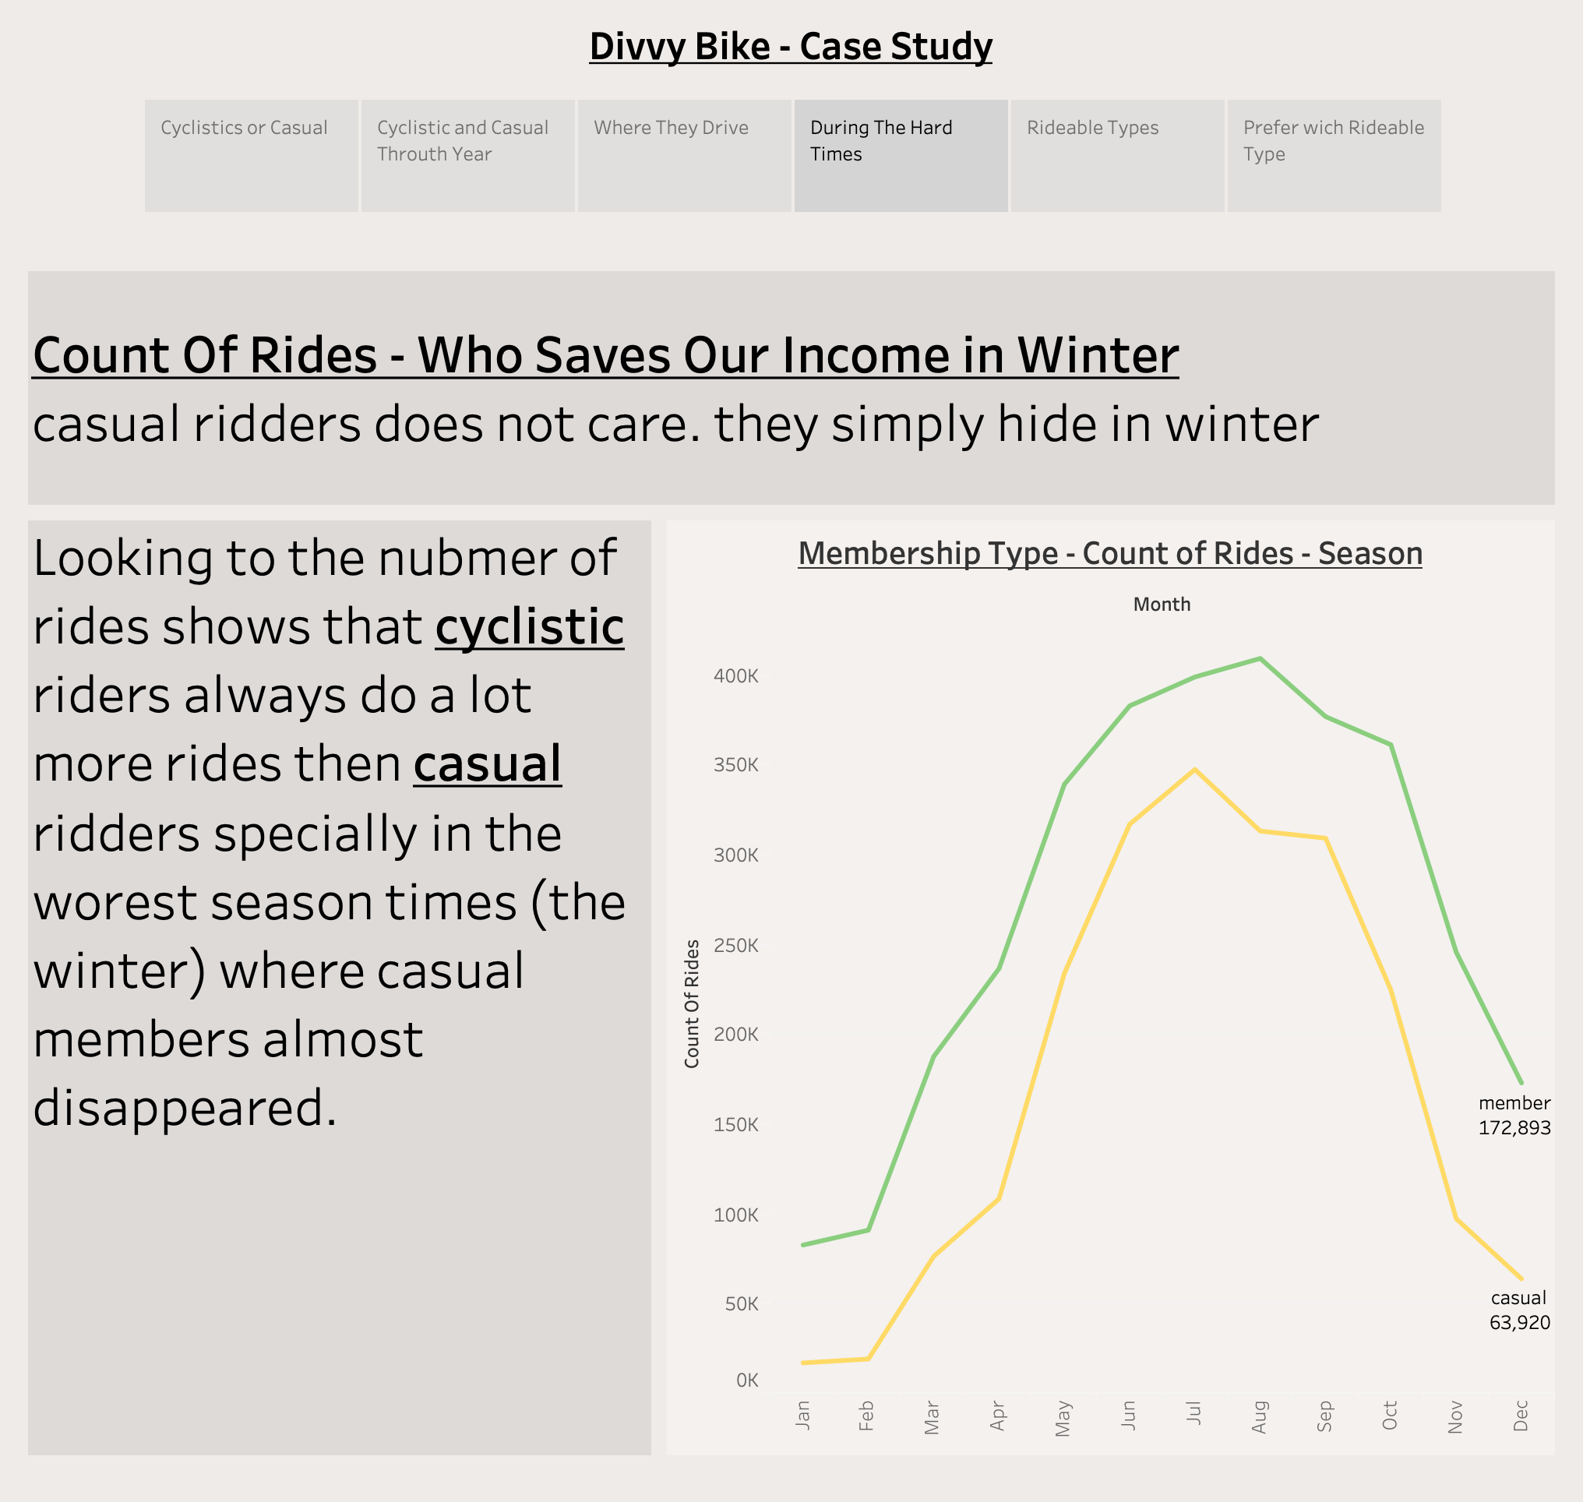

Slide 6
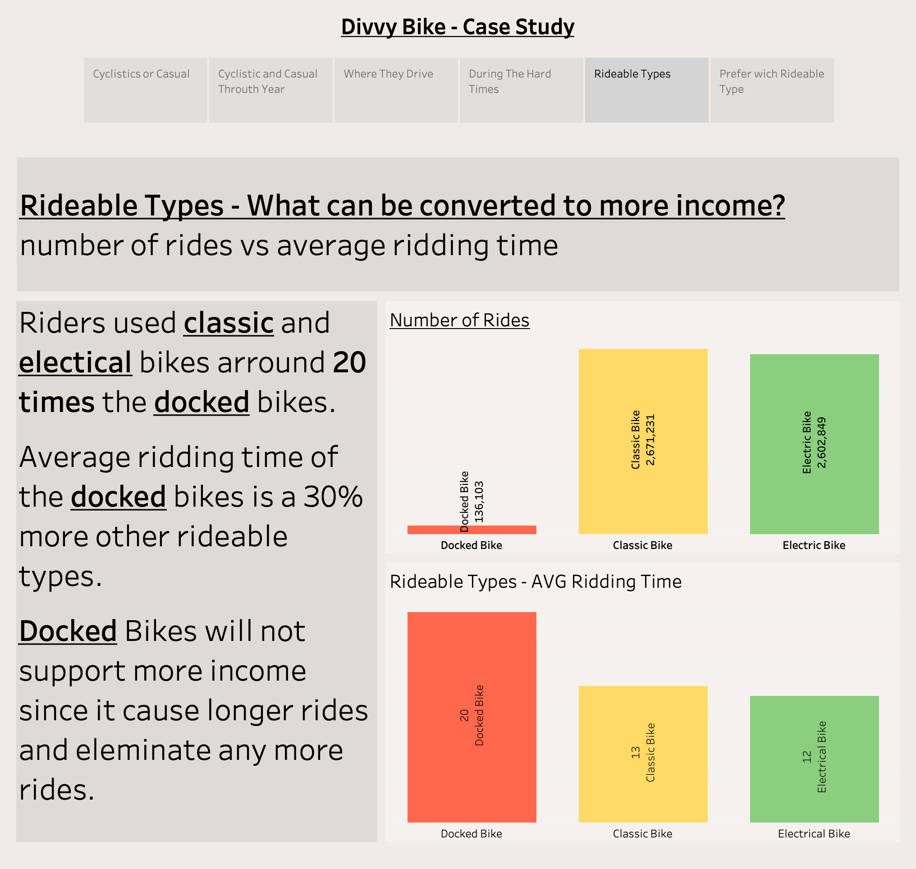

Slide 7
